Slide 1
Automated Testing
Finding Bugs
Notes:
1

Slide 2
Testing Principles
Check compliance with requirements
Check compliance after changes (regression)
Methodology to isolate problems
Reduce costs of maintenance
Notes:
2

Slide 3
Good practices
Requirements are clearly testable
Write tests offline
Create tests for ranges of values and boundaries
Create tests for types
Create tests for multiple states
Think of all the extremes

Slide 4
Types of Test
Functional
Behavioral
Performance
Integration
System
What types of tests we could write

Slide 5
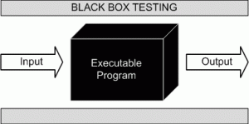
Functional Test

Slide 6
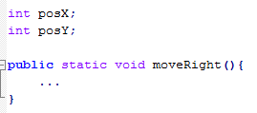
Behavioral Test (state)

Slide 7

Performance Testing

Slide 8
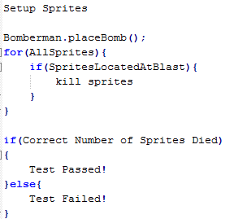
Integration Testing

Slide 9
JUnit
Getting Set up
Testing Library

Slide 10
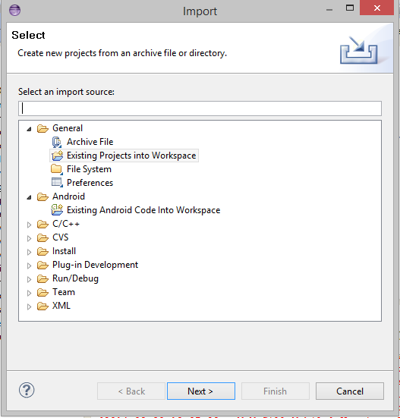
Importing a project
File -> Import -> Existing project into Workspace -> Browse for project

Slide 11
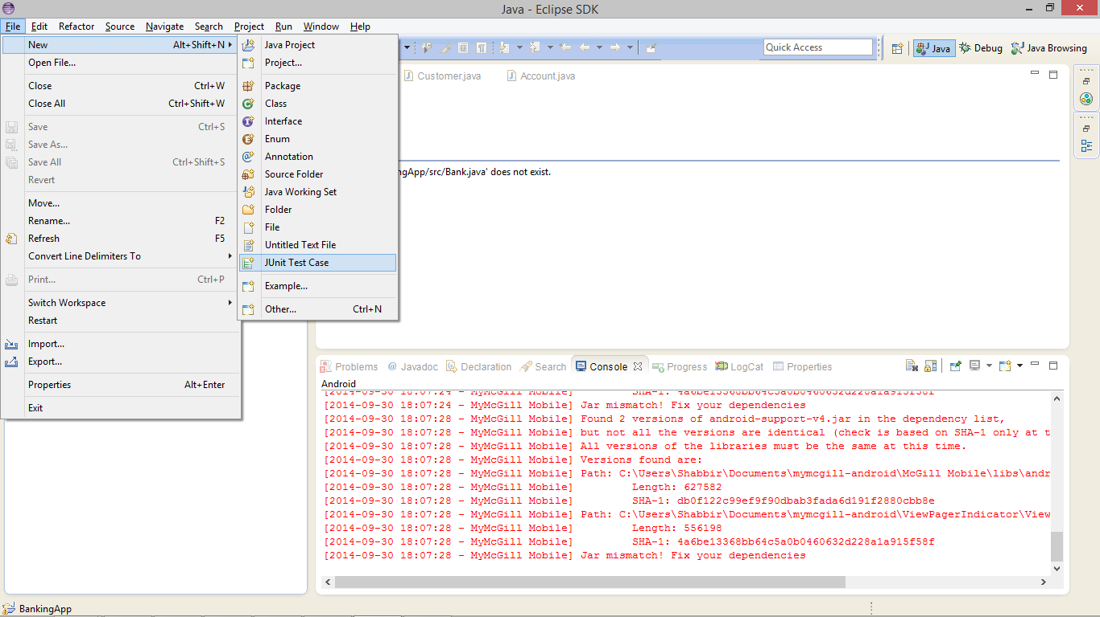
Setting up a Test
File -> new-> Junit Test case

Slide 12
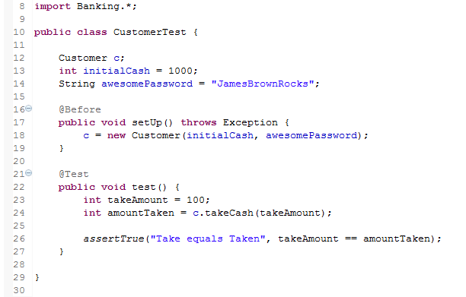
Junit Structure
Import Classes under test
Declare Objects under Test
Flag to execute this method before test
Flag to indicate this method is a test case
Assertion decides if test will pass or fail

Slide 13
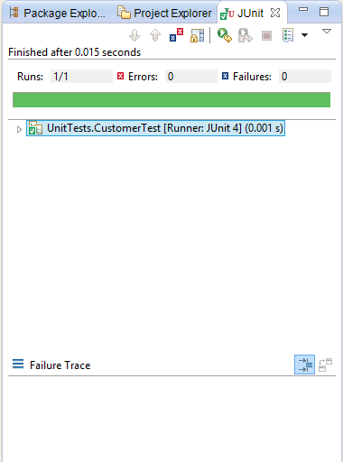
Running Tests
Right Click on Test class -> Run as -> JunitTest

Slide 14
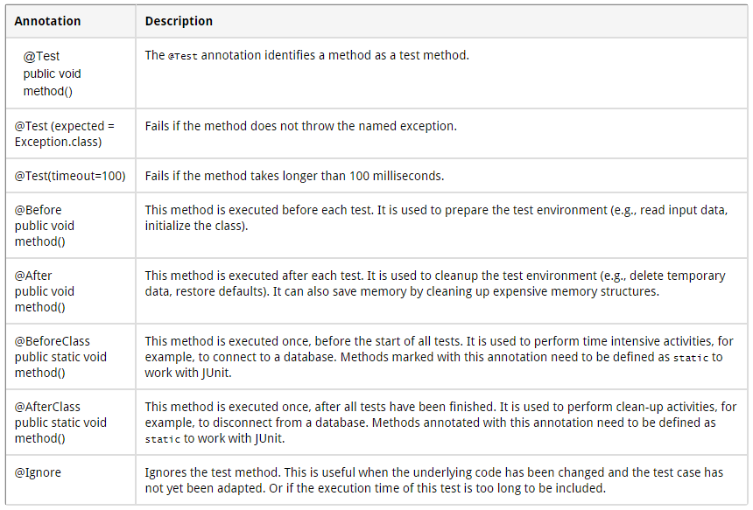
Junit Annotations
Notes:
Taken from http://www.vogella.com/tutorials/JUnit/article.html
14

Slide 15
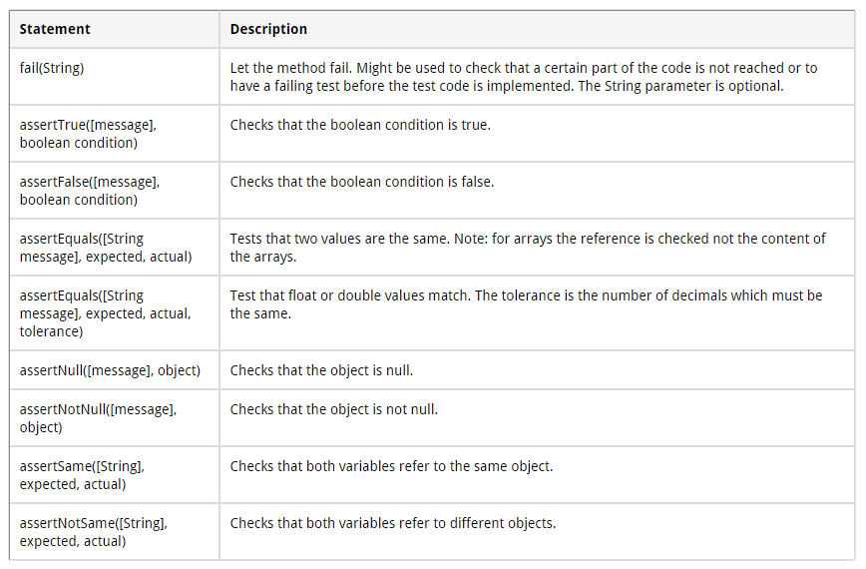
Junit Assertions
Notes:
Taken from http://www.vogella.com/tutorials/JUnit/article.html
15

Slide 16

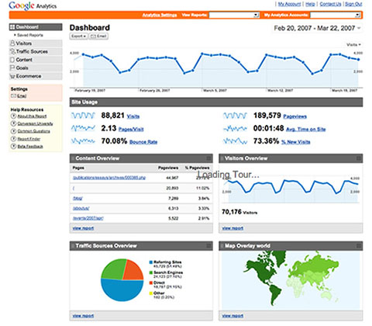
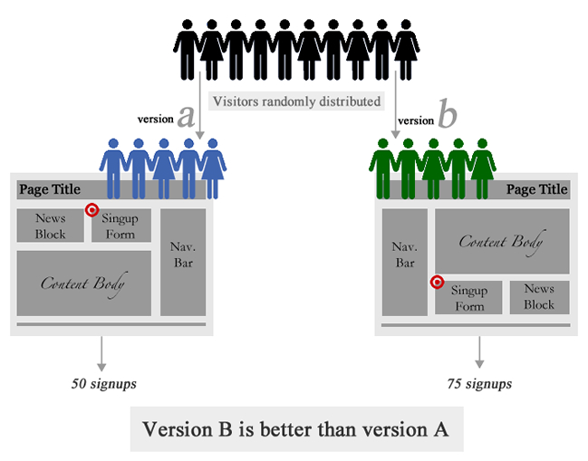

Alternative Testing Methods

